Slide 1
Week 5
Alexey V. Zimin
JHU BME 580.417/707

Slide 2
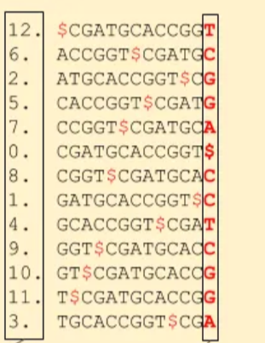
Lab #3: Burrows-Wheeler Alignment
sequence: CGATGCACCGGT
Lab #3: Burrows-Wheeler Transform and Search
Due Friday October 9th at 8:00pm.
Undergraduate and Graduate: Implement function burrows_wheeler_transform(string seq) that returns three objects:
  (U: 30pt, G: 25pt) BWT string
  (U: 30pt, G: 25pt) Suffix array (zero-based set of integers)
  (U: 40pt, G: 25pt) First letters of the suffix array string
Graduate only (25pt): implement function bwt_search_exact(string pattern, string bwt, array suffix_array, string first_column) that returns
  array of zero-based positions of the beginning of the pattern in seq
  Only compute forward matches
  Example output for pattern “CG” is [ 0, 8 ]
  Report matches in any order
Name file bwt.py and submit to autograder in Gradescope
Suffix array
BWT
The first column

Slide 3
Lab #3: Burrows-Wheeler Alignment
sequence: CGATGCACCGGT
Lab #3: Burrows-Wheeler Transform and Search
Due Friday October 9th at 8:00pm.
Undergraduate and Graduate: Implement function burrows_wheeler_transform(string seq) that returns three objects:
  (U: 30pt, G: 25pt) BWT string
  (U: 30pt, G: 25pt) Suffix array (zero-based set of integers)
  (U: 40pt, G: 25pt) First letters of the suffix array string
Graduate only (25pt): implement function bwt_search_exact(string pattern, string bwt, array suffix_array, string first_column) that returns
  array of zero-based positions of the beginning of the pattern in seq
  Only compute forward matches
  Example output for pattern “CG” is [ 0, 8 ]
  Report matches in any order
Name file bwt.py and submit to autograder in Gradescope
Suffix array
BWT
The first column

Slide 4
Choosing the right sequencing strategy
The right sequencing strategy depends on your budget and availability of sequencing services
The simplest strategy: get 30-40x genome coverage with PacBio HiFi reads
Alternative strategy: get 30-40x genome coverage with Oxford Nanopore reads + 30-50x coverage with Illumina reads
  Perform hybrid assembly (correct ONT with Illumina first)
  Assemble ONT reads and then correct assembly with Illumina
For chromosome-sized scaffolds you may need ONT Ultralongs or Hi-C reads

Slide 5
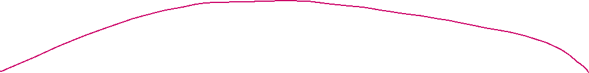


Assembly levels
Contigs are contiguous genome sequences where all letters are known
Scaffolds are ordered and oriented sets of contigs, gaps between contigs are of estimated size or set to a default value
Super-scaffolds or pseudo-chromosomes are ordered and mostly oriented sets of scaffolds, gaps between scaffolds are typically not estimated

Slide 6
Genome assembly strategies
Contig assembly uses reads:
  Overlap Graph
    String graph
  K-mer (or DeBruijn) graph
Scaffolding/super-scaffolding uses
  Long reads or
  Oriented or unoriented pairs of reads

Slide 7
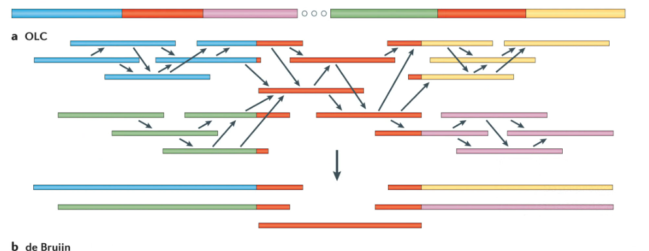
Overlap-Layout-Consensus
Overlap – compute overlaps between reads based on sequence alignments
Layout – assemble overlapping reads (greedy or string graph)
Consensus – generate contig sequences, by majority vote
Chaisson et al., (2015)

Slide 8
Overlap
An overlap is an pseudo-alignment between a pair of reads
Can be Inverse
Or Forward

Slide 9
Recording an overlap
Choose the first read, it is always forward, it specifies the coordinate system
Record orientation
Record overhangs (A and B), read ends are coordinate starts
A-overhang(positive)
B-overhang (positive)
A-overhang(negative)
B-overhang (negative)
A-overhang(negative)
B-overhang (positive)
Contained overlap

Slide 10
Overlap is not an alignment
In there are indels, you can choose the longest stretch without them
Record R1, R2, orientation, A-hang, B-hang, overlap length or quality
AGATAGACATAGACATAGACAGATACAC
ATAGACACAGACTATAGGCAGATACACTCGAT
AGATAGACATAGACATAGACAGATACAC
ATAGACACAGACTATAGGCAGATACACTCGAT
R1(+): AGATAGACATAGACATAGACAGATACAC
R2(- implies that we had to RC): ATAGACACAGACTATAGGCAGATACACTCGAT
Overlap:
R1 R2 – 1 5 27 or
R1 R2 – 2 5 26

Slide 11
OLC strategies: Greedy
Greedy assembly algorithm will always yield an assembly, but not necessarily the right one:
  Search for overlaps. If there is more than 1 sequence that overlaps, find the sequence overlap with the highest area of overlap.
  Find two fragments with largest overlap and merge fragments.
  Always try to extend
  Repeat until all overlaps are used or rejected.
Strengths: Simple to implement and generally fast.
Weaknesses: Can make mistakes in assemblies.
Example: Imagine assembling a puzzle by always joining the two best matching pieces, even if those pieces might not be part of the final correct arrangement.

Slide 12
Example of a greedy assembly
Genome AACATAAAAAAAGACGAAAAAAACGTC
Reads
R1:AACATAA
R2:ATAAAAA
R3:AAAAAAG
R4:AAGACGA
R5:GACGAAA
R6:AAAAAAA
R7:AAACGTC
Problem: recover the genome using each read once
Longest overlap is between R3 and R6!
Overlaps (min 3):
R1 R2 4
R2 R3 5
R2 R6 5
R2 R7 3
R3 R4 3
R3 R5 3
R3 R6 6
R4 R5 5
R5 R6 3
R5 R7 3
R6 R7 3

Slide 13
Example of a greedy assembly
Genome AACATAAAAAAAGACGAAAAAAACGTC
Reads
R3:AAAAAAG
R6:AAAAAAA
Overlaps (min 3):
R1 R2 4
R2 R3 5
R2 R6 5
R2 R7 3
R3 R4 3
R3 R5 3
R3 R6 6
R4 R5 5
R5 R6 3
R5 R7 3
R6 R7 3

Slide 14
Example of a greedy assembly
Genome AACATAAAAAAAGACGAAAAAAACGTC
Reads
R2:ATAAAAA ?
R3:AAAAAAG
R6:AAAAAAA
R2:ATAAAAA ?
Overlaps (min 3):
R1 R2 4
R2 R3 5
R2 R6 5
R2 R7 3
R3 R4 3
R3 R5 3
R3 R6 6
R4 R5 5
R5 R6 3
R5 R7 3
R6 R7 3

Slide 15
Example of a greedy assembly
Genome AACATAAAAAAAGACGAAAAAAACGTC
Reads
R3:AAAAAAG
R6:AAAAAAA
R2:ATAAAAA
R4:AAGACGA
R5:GACGAAA
Overlaps (min 3):
R1 R2 4
R2 R3 5
R2 R6 5
R2 R7 3
R3 R4 3
R3 R5 3
R3 R6 6
R4 R5 5
R5 R6 3
R5 R7 3
R6 R7 3

Slide 16
Example of a greedy assembly
Genome AACATAAAAAAAGACGAAAAAAACGTC
Reads
R1:AACATAA
R3:AAAAAAG
R6:AAAAAAA
R2:ATAAAAA
R4:AAGACGA
R5:GACGAAA
Overlaps (min 3):
R1 R2 4
R2 R3 5
R2 R6 5
R2 R7 3
R3 R4 3
R3 R5 3
R3 R6 6
R4 R5 5
R5 R6 3
R5 R7 3
R6 R7 3

Slide 17
Example of a greedy assembly
Genome AACATAAAAAAAGACGAAAAAAACGTC
Reads
R1:AACATAA
R3:AAAAAAG
R6:AAAAAAA
R2:ATAAAAA
R7:AAACGTC ?
R4:AAGACGA
R5:GACGAAA
R7:AAACGTC ?
Overlaps (min 3):
R1 R2 4
R2 R3 5
R2 R6 5
R2 R7 3 X
R3 R4 3
R3 R5 3 X
R3 R6 6
R4 R5 5
R5 R6 3 X
R5 R7 3
R6 R7 3

Slide 18
Example of a greedy assembly
Genome AACATAAAAAAAGACGAAAAAAACGTC
Reads
R1:AACATAA
R3:AAAAAAG
R6:AAAAAAA
R2:ATAAAAA
R4:AAGACGA
R5:GACGAAA
R7:AAACGTC ?
Overlaps (min 3):
R1 R2 4
R2 R3 5
R2 R6 5
R2 R7 3 X
R3 R4 3
R3 R5 3 X
R3 R6 6
R4 R5 5
R5 R6 3 X
R5 R7 3
R6 R7 3

Slide 19
Example of a greedy assembly
Genome AACATAAAAAAAGACGAAAAAAACGTC
Reads
R1:AACATAA
R3:AAAAAAG
R6:AAAAAAA
R2:ATAAAAA
R4:AAGACGA
R5:GACGAAA
R7:AAACGTC
Overlaps (min 3):
R1 R2 4
R2 R3 5
R2 R6 5
R2 R7 3 X
R3 R4 3
R3 R5 3 X
R3 R6 6
R4 R5 5
R5 R6 3 X
R5 R7 3
R6 R7 3

Slide 20
Example of a greedy assembly
Genome AACATAAAAAAAGACGAAAAAAACGTC
Reads
R1:AACATAA
R3:AAAAAAG
R6:AAAAAAA
R2:ATAAAAA
R4:AAGACGA
R5:GACGAAA
R7:AAACGTC
Assembly
AACATAAAAAAAGACGAAACGTC
Overlaps (min 3):
R1 R2 4
R2 R3 5
R2 R6 5
R2 R7 3 X
R3 R4 3
R3 R5 3 X
R3 R6 6
R4 R5 5
R5 R6 3 X
R5 R7 3
R6 R7 3

Slide 21
OLC strategies: String graph
String graph:
  Construct a graph where each read is a node and an edge connects two reads if they overlap.
  Merge unique edges/remove transitive edges (e.g. A->B, B->C and A->C, remove B->C if unique).
  Contigs are a set of linear paths through the graph, split at all intersections

Slide 22
OLC strategies: String graph
String graph:
  Construct a graph where each read is a node and an edge connects two reads if they overlap.
  Merge unique edges/remove transitive edges (e.g. A->B, B->C and A->C, remove B->C if unique).
  Contigs are a set of linear paths through the graph, split at all intersections

Slide 23
OLC strategies: String graph
String graph:
  Construct a graph where each read is a node and an edge connects two reads if they overlap.
  Merge unique edges/remove transitive edges (e.g. A->B, B->C and A->C, remove B->C if unique).
  Contigs are a set of linear paths through the graph, split at all intersections

Slide 24
OLC strategies: String graph
Strengths:
  Assemblies are more correct, because the graph structure preserves information about all overlaps, not just the strongest ones.
  Storing assembly as a graph can help resolve it later with additional data
Weaknesses: More computationally intensive. Building the initial overlap graph is typically the slowest part of the assembly.
Example: Imagine creating a map of all possible connections between puzzle pieces and then finding the optimal path through the connections to assemble the puzzle.

Slide 25
Example of a string graph assembly
Genome AACATAAAAAAAGACGAAAAAAACGTC
Reads
R1:AACATAA
R2:ATAAAAA
R3:AAAAAAG
R4:AAGACGA
R5:GACGAAA
R6:AAAAAAA
R7:AAACGTC
Overlaps (min 3):
R1 R2 4
R2 R3 5
R2 R6 5
R2 R7 3
R3 R4 3
R3 R5 3
R3 R6 6
R4 R5 5
R5 R6 3
R5 R7 3
R6 R7 3

Slide 26
Example of a string graph assembly
Genome AACATAAAAAAAGACGAAAAAAACGTC
Reads
R1:AACATAA
R2:ATAAAAA
R3:AAAAAAG
R4:AAGACGA
R5:GACGAAA
R6:AAAAAAA
R7:AAACGTC
String graph: Reduce R1 R2 and R4 R5
R1-R2: AACATAAAAA
R4-R5: AAGACGAAA
Overlaps (min 3):
R1 R2 4
R2 R3 5
R2 R6 5
R2 R7 3
R3 R4 3
R3 R5 3
R3 R6 6
R4 R5 5
R5 R6 3
R5 R7 3
R6 R7 3

Slide 27
Example of a string graph assembly
Genome AACATAAAAAAAGACGAAAAAAACGTC
Reads
R1:AACATAA
R2:ATAAAAA
R3:AAAAAAG
R4:AAGACGA
R5:GACGAAA
R6:AAAAAAA
R7:AAACGTC
String graph: Construct the graph
AAACGTC
AACATAAAAA
AAAAAAA
AAAAAAG AAACGTC
AAGACGAAA
AAGACGAAA
Assembly: AACAT GACG AAAAAAA CGTC
Overlaps (min 3):
R1 R2 4
R2 R3 5
R2 R6 5
R2 R7 3
R3 R4 3
R3 R5 3
R3 R6 6
R4 R5 5
R5 R6 3
R5 R7 3
R6 R7 3

Slide 28
Example of a string graph assembly
Genome AACATAAAAAAAGACGAAAAAAACGTC
Reads
R1:AACATAA
R2:ATAAAAA
R3:AAAAAAG
R4:AAGACGA
R5:GACGAAA
R6:AAAAAAA
R7:AAACGTC
String graph: Construct the graph
AAACGTC
AACATAAAAA
AAAAAAA
AAAAAAG AAACGTC
AAGACGAAA
AAGACGAAA
Assembly: AACAT GACG AAAAAAA CGTC
Overlaps (min 3):
R1 R2 4
R2 R3 5 X
R2 R6 5
R2 R7 3
R3 R4 3
R3 R5 3
R3 R6 6
R4 R5 5
R5 R6 3
R5 R7 3
R6 R7 3

Slide 29
Example of a string graph assembly
Genome AACATAAAAAAAGACGAAAAAAACGTC
Reads
R1:AACATAA
R2:ATAAAAA
R3:AAAAAAG
R4:AAGACGA
R5:GACGAAA
R6:AAAAAAA
R7:AAACGTC
String graph: Construct the graph
AAACGTC
AACATAAAAA
AAAAAAA
AAAAAAG AAACGTC
AAGACGAAA
AAGACGAAA
Assembly: AACAT GACG AAAAAAA CGTC
Overlaps (min 3):
R1 R2 4
R2 R3 5 X
R2 R6 5
R2 R7 3
R3 R4 3
R3 R5 3
R3 R6 6
R4 R5 5
R5 R6 3
R5 R7 3
R6 R7 3

Slide 30
Example of a string graph assembly
Genome AACATAAAAAAAGACGAAAAAAACGTC
Reads
R1:AACATAA
R2:ATAAAAA
R3:AAAAAAG
R4:AAGACGA
R5:GACGAAA
R6:AAAAAAA
R7:AAACGTC
String graph: Partition at “branches”
AAACGTC
AACATAAAAA
AAAAAAA
AAAAAAG AAACGTC
AAGACGAAA
AAGACGAAA
Contigs: AACAT GACG AAAAAAA CGTC
Overlaps (min 3):
R1 R2 4
R2 R3 5 X
R2 R6 5
R2 R7 3
R3 R4 3
R3 R5 3
R3 R6 6
R4 R5 5
R5 R6 3
R5 R7 3
R6 R7 3

Slide 31
Example of a string graph assembly
Genome AACATAAAAAAAGACGAAAAAAACGTC
Reads
R1:AACATAA
R2:ATAAAAA
R3:AAAAAAG
R4:AAGACGA
R5:GACGAAA
R6:AAAAAAA
R7:AAACGTC
String graph: Remove “tips”
AAACGTC
AACATAAAAA
AAAAAAA
AAAAAAG
AAGACG
GACGAAA
Contigs: AACAT GACG AAAAAAA CGTC
Overlaps (min 3):
R1 R2 4
R2 R3 5 X
R2 R6 5
R2 R7 3
R3 R4 3
R3 R5 3
R3 R6 6
R4 R5 5
R5 R6 3
R5 R7 3
R6 R7 3

Slide 32
Example of a string graph assembly
Genome AACATAAAAAAAGACGAAAAAAACGTC
Reads
R1:AACATAA
R2:ATAAAAA
R3:AAAAAAG
R4:AAGACGA
R5:GACGAAA
R6:AAAAAAA
R7:AAACGTC
String graph:
Overlaps (min 3):
R1 R2 4
R2 R3 5 X
R2 R6 5
R2 R7 3
R3 R4 3
R3 R5 3
R3 R6 6
R4 R5 5
R5 R6 3
R5 R7 3
R6 R7 3
AACAT
CGTC
AAAAAAA
GCAG

Slide 33
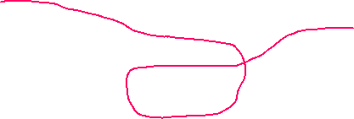
Example of a string graph assembly
Genome AACATAAAAAAAGACGAAAAAAACGTC
Reads
R1:AACATAA
R2:ATAAAAA
R3:AAAAAAG
R4:AAGACGA
R5:GACGAAA
R6:AAAAAAA
R7:AAACGTC
String graph: assembly
Overlaps (min 3):
R1 R2 4
R2 R3 5
R2 R6 5
R2 R7 3
R3 R4 3
R3 R5 3
R3 R6 6
R4 R5 5
R5 R6 3
R5 R7 3
R6 R7 3
AACAT
CGTC
AAAAAAA
GCAG

Slide 34

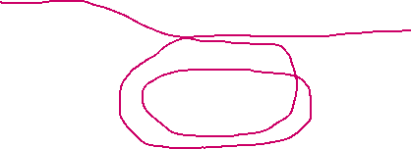
Example of a string graph assembly
Genome AACATAAAAAAAGACGAAAAAAACGTC
String graph: assembly
Genome AACATAAAAAAAGACGAAAAAAAGACGAAAAAAACGTC produces the same graph:
AACAT
CGTC
AAAAAAA
GCAG
AACAT
CGTC
AAAAAAA
Can use coverage to estimate repeat multiplicity
GCAG

Slide 35
Consensus
Reads have errors, overlaps are typically not perfect
In each contig we need to compute consensus sequence
AGATAGACAAAGACATAGACAGATACGC
ATAGACACAGACTATAGGCAGATACACTCGAT
GACATAGACATAGACAGGATACGCTCG
ACATAGATATAGACAGGATACACTCGA
TAGACAGGATACACTCGATCGGGT

Slide 36
Computing consensus sequence
Produce “backbone” contig
AGATAGACAAAGACATAGACAGATACGCTCGATCGGGT
AGATAGACAAAGACATAGACAGATACGC
ATAGACACAGACTATAGGCAGATACACTCGAT
GACATAGACATAGACAGGATACGCTCG
ACATAGATATAGACAGGATACACTCGA
TAGACAGGATACACTCGATCGGGT

Slide 37
Computing consensus sequence
Produce multi-alignment to “backbone” contig
AGATAGACAAAGAC-ATAGACAG-ATACGCTCGATCGGGT AGATAGACAAAGAC-ATAGACAG-ATACGC
ATAGACACAGACTATAGGCAG-ATACACTCGAT
GACATAGAC-ATAGACAGGATACGCTCG
ACATAGA-TATAGACAGGATACACTCGA
TAGACAGGATACACTCGATCGGGT

Slide 38
Computing consensus sequence
Produce consensus sequence
AGATAGACATAGACTATAGACAGGATACACTCGATCGGGT AGATAGACAAAGAC-ATAGACAG-ATACGC
ATAGACACAGACTATAGGCAG-ATACACTCGAT
GACATAGAC-ATAGACAGGATACGCTCG
ACATAGA-TATAGACAGGATACACTCGA
TAGACAGGATACACTCGATCGGGT

Slide 39
Assembly polishing
Contig sequence produced by assemblers contains errors, especially if ONT data was used:
AGACATAGACGAAGACATAGGTA
We can fix errors by aligning low error reads (Illumina or HiFi) to the assembly:
AGACATAGACGA*AGACATAGGTA
AGACACAG
CACAGACGATAGA
ACAGACGATAGACGTAGGT
ATAGACGTAGGT
AGACCTAGGTA
ACGTAGGTA
This is called polishing

Slide 40
Assembly polishing
Caution on polishing: if the reads were not used for the original assembly, they may come from regions that are missing from the assembly, but similar to another region present in the assembly
In this case read aligner may align the reads to the wrong place
Polishing programs try to deal with these cases by looking for reads that agree with the assembly, but in low-coverage regions there may be not enough of them

Slide 41
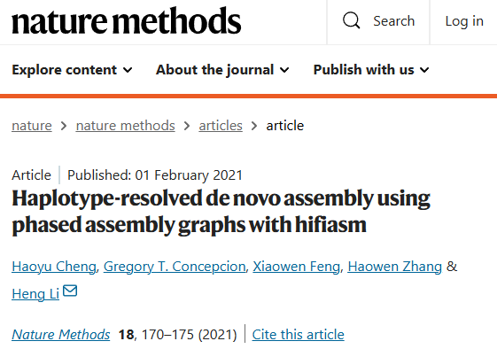
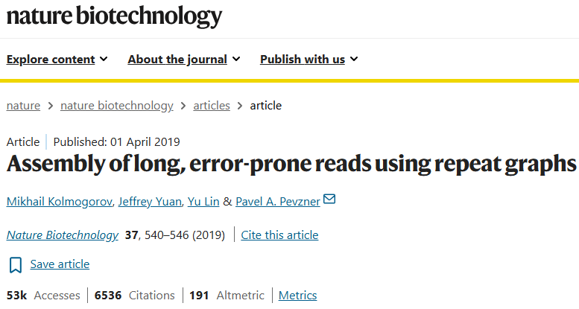
Genome assemblers that use string graph
Hifiasm -- for PacBio HiFi or Oxford Nanopore (the latest R10 only!)
Flye -- for Oxford Nanopore (and PacBio CLR/HiFi)

Slide 42
Hifiasm
Used for PacBio HiFi data or the latest (R10.4) ONT data (beta)
Can do haplotype-resolved assemblies with HiC data
Fast and accurate ( <1000 CPU-hours for human genome)
Error corrects reads, uses string graph with exact overlaps
Can produce assemblies with T2T chromosomes
Outputs assembly in graph format (.gfa)
Use gfatools to output fasta:
  gfatools gfa2fa in.gfa > out.fa

Slide 43
Flye
Used for Oxford Nanopore (ONT) and PacBio CLR/HiFi data
Relatively fast (human genome takes ~5000 CPU-hours)
Builds string graph from original reads
The best option for ONT reads
Outputs assembly in fasta and graph format (.fa and .gfa)
ONT-based assemblies need polishing

Slide 44
K-mer graph assembly
Break reads into overlapping k-mers of fixed length K; for example, K = 5:
AGACATAGAC
AGACA
GACAT
ACATA
CATAG
ATAGA
TAGAC
Count all k-mers in the reads, build a table of kmer-count (use canonical k-mers)
AGACA 5
ATGTC 20
…
Build k-mer graph, k-mers are nodes and k+1 - mers are edges

Slide 45
K-mer graph
Let’s build 5-mer graph, 5-mers are nodes and 6-mers are edges. For example:
node node
AGACA GACAT
none A
  edge (AGACAT)

Slide 46
K-mer graph
Let’s build 5-mer graph, 5-mers are nodes and 6-mers are edges. Start with AGACA,check continuations in both directions
AGACA
none A A -none
none C C 5
none G G 10
15 T T -none

Slide 47
K-mer graph
Let’s build 5-mer graph, 5-mers are nodes and 6-mers are edges. Start with AGACA,check continuations in both directions
GACAC
AGACA
GACAG none A
This is a forward “branch”. Stop extending AGACA forward and go backward.

Slide 48
K-mer graph
Let’s build 5-mer graph, 5-mers are nodes and 6-mers are edges. Start with AGACA,check continuations in both directions
GACAC
AGACA
none A GACAG
none C
none G
15 T none A

Slide 49
K-mer graph
Let’s build 5-mer graph, 5-mers are nodes and 6-mers are edges. Start with AGACA,check continuations in both directions
GACAC
TAGAC AGACA
we can collapse the unique edge GACAG
none Acolla
Possibly unique continuation? Check backward edges of the next k-mer (TAGAC) for possible backward branch

Slide 50
K-mer graph
Let’s build 5-mer graph, 5-mers are nodes and 6-mers are edges. Start with AGACA,check continuations in both directions
GACAC
TAGAC AGACA
we can colnone C GACAG
none G
none T
none Acolla
Possibly unique continuation? Check backward edges of the next k-mer (TAGAC) for possible backward branch

Slide 51
K-mer graph
Let’s build 5-mer graph, 5-mers are nodes and 6-mers are edges. Start with AGACA,check continuations in both directions
GACAC
TAGAC AGACA
we can colnone C GACAG
none G
none T
none Acolla
Unique in both directions! We can extend!

Slide 52
K-mer graph
Let’s build 5-mer graph, 5-mers are nodes and 6-mers are edges. Start with AGACA,check continuations in both directions
GACAC
TAGAC AGACA
we can colnone C GACAG
none G
none T
none Acolla
unique edge

Slide 53
K-mer graph
Let’s build 5-mer graph, 5-mers are nodes and 6-mers are edges. Start with AGACA,check continuations in both directions
GACAC
TAGACA
none A GACAG
none A
We can collapse the unique edge and continue until we encounter forward or backward branch.

Slide 54
K-mer graph
Let’s build 5-mer graph, 5-mers are nodes and 6-mers are edges. Start with AGACA,check continuations in both directions
GACAC
TAGACA
none A GACAG
none A
We can collapse the unique edge and continue until we encounter forward or backward branch.

Slide 55
K-mer graph
We can end up with a complicated graph
TGACA
AAGTCTAGA GACACTGGGTGT
GAAGT TAGACA CAGTACCC
AAGTGTAGA A GACAGT
none A CAGTTCTG
Now we have to walk the graph to reconstruct the genome sequence

Slide 56
Properties of the k-mer graph
Each k-mer is encountered only ONCE in the graph
An assembly is a path that visits each node (k-mer) at least once
Can use k-mer counts to see how many times need to go through each node

Slide 57
K-unitigs
K-unitigs are DNA sequences that correspond to strictly linear (non-branching) paths through k-mer graph where each node (k-mer) is used only once:
  No forward or backward branches allowed
  Can overlap exactly by K-1 bases with one or more other K-unitigs
  All K-mers in k-unitigs are distinct (no K-mer is repeated twice)
A more compact representation of k-mer graph
  K-unitigs are nodes
  K+1 -mers are edges

Slide 58
K-unitigs
Example: K=9, FIVE K-unitigs
GATAACAAAGATAGAC ATGAGACTAAATAA
AGATAGACATAACAAGATACATCAATGAGACT
AGATACGACAATAGATAGAC ATGAGACTAAACATGAC

Slide 59
K-unitigs
Example: K=9
GATAACAAAGATAGAC ATGAGACTAAATAA
AGATAGACATAACAAGATACATCAATGAGACT
AGATACGACAATAGATAGAC ATGAGACTAAACATGAC
Four paths

Slide 60
K-unitigs
Example: K=9
GATAACAAAGATAGAC ATGAGACTAAATAA
AGATAGACATAACAAGATACATCAATGAGACT
AGATACGACAATAGATAGAC ATGAGACTAAACATGAC
Four paths

Slide 61
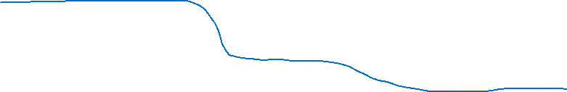
K-unitigs
Example: K=9
GATAACAAAGATAGAC ATGAGACTAAATAA
AGATAGACATAACAAGATACATCAATGAGACT
AGATACGACAATAGATAGAC ATGAGACTAAACATGAC
Four paths

Slide 62
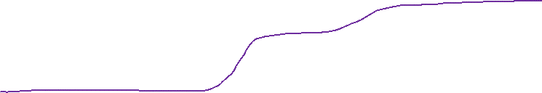
K-unitigs
Example: K=9
GATAACAAAGATAGAC ATGAGACTAAATAA
AGATAGACATAACAAGATACATCAATGAGACT
AGATACGACAATAGATAGAC ATGAGACTAAACATGAC
Four paths

Slide 63
K-unitigs
Example: K=9
GATAACAAAGATAGAC ATGAGACTAAATAA
AGATAGACATAACAAGATACATCAATGAGACT
AGATACGACAATAGATAGAC ATGAGACTAAACATGAC
Four paths
GATAACAAAGATAGACATAACAAGATACATCAATGAGACTAAATAA
AGATACGACAATAGATAGACATAACAAGATACATCAATGAGACTCAACATGAC
AGATACGACAATAGATAGACATAACAAGATACATCAATGAGACTAAATAA
GATAACAAAGATAGACATAACAAGATACATCAATGAGACTCAACATGAC

Slide 64
Path vs trail in graph theory
Path and trail are two ways to walk a graph consisting of nodes (vertices) and edges
A trail is a walk in which all edges are distinct.
  Nodes may repeat
  Edges may not repeat
A path is a trail in which all nodes are distinct.
  No repeated nodes
  No repeated edges (automatically true if nodes don’t repeat)
Path is stricter version of a trail
  Every path is a trail
  Not every trail is a path
Assembly is:
  Eulerian walk through the k-mer graph (trail that visits each edge exactly once) or
  Hamiltonian path through the k-mer graph (path that visits each node or vertex exactly once)

Slide 65
Why DeBruijn of K-mer graph?
If k-mers are nodes then assembly can be a path that visits each node at least once
This is Hamiltonian path problem, which is NP-complete (both NP and NP-hard)
In our K-mer graph (k+1)-mers are edges: we can reform a problem as Eulerian path problem (trail that visits each edge once), which can be solved in linear time
K-mers are now nodes, they can be visited more than once
Repeats create multiple edges, not repeated traversal of a single edge.

Slide 66
DeBruijn graph vs k-mer graph
K=K’-1
DeBruijn graph and k-mer graph are the same concept
DeBruijn graph (K) == k-mer graph (K-1)
AGCTG AGCTG
GCTGT GCTGT
K K-1
Note that genome assembly as a Eulerian path (trail that visits each edge once) is not a practical approach for either graph, unless k-mers are longer than the longest exact repeat.
 | DeBruijn graph (K) | K-mer graph (K’)
Edge size | K | K’+1
Vertex (node) size | K-1 | K’
Overlap length | K-2 | K’-1
Unique element | K-1 -- mer | K’ -- mer
K-mer size to count for building | K-1 | K’

Slide 67
DeBruijn graph vs k-mer graph
K=K’-1
DeBruijn graph and k-mer graph are the same concept
DeBruijn graph (K) == k-mer graph (K-1)
AGCTG AGCTG
GCTGT GCTGT
K K-1
Note that genome assembly as a Eulerian path (trail that visits each edge once) is not a practical approach for either graph, unless k-mers are longer than the longest exact repeat in a genome.
 | DeBruijn graph (K) | K-mer graph (K’)
Edge size | K | K’+1
Vertex (node) size | K-1 | K’
Overlap length | K-2 | K’-1
Unique element | K-1 -- mer | K’ -- mer
K-mer size to count for building | K-1 | K’

Slide 68
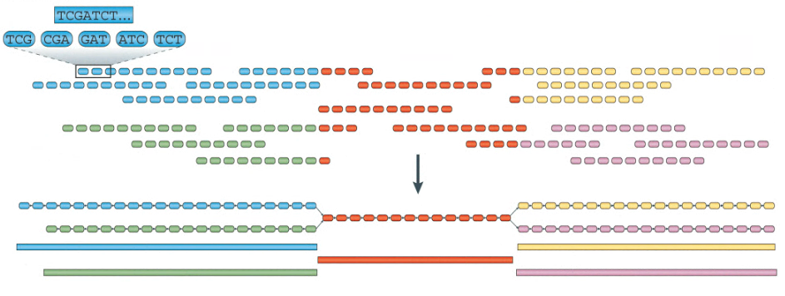
K-mer graph assembly example
Assemble a region of the genome
unique
repeat
unique
unique
repeat
unique
DeBruijn graph of 4-mers or K-mer graph of 3-mers
repeat
Chaisson et al., (2015)

Slide 69
Combining OLC and K-mer graph
Shortcoming of k-mer graph:
  repeats that are longer than a k-mer but shorter than a read cause unnecessary ambiguous edges or “forks” in the assembly graph
  high memory requirements, not feasible for large genomes
There are assembly techniques that combine k-mer graph and OLC
Super-reads used in MaSuRCA assembler
The idea is to use k-mer graph to extend the reads, preserving K-mer adjacency information to reduce the number of edges in the K-mer graph

Slide 70
Super-reads
Count all k-mers in the input reads, create hash count{kmer}
For read
AGATGACAGATCAGATGCAT
GAGATGA ATGCATG
TGAGATGA TGCATGC
AGAGATGA GCATGCA
stop GCATGCT
stop
Produce super-read GAGATGACAGATCAGATGCATGC
Many short reads extend to the same super-read!!!

Slide 71
Super-reads
Count all k-mers in the input reads, create hash count{kmer}
For read
AGATGACAGATCAGATGCAT
GAGATGA ATGCATG
TGAGATGA TGCATGC
AGAGATGA GCATGCA
stop GCATGCT
stop
Produce super-read GAGATGACAGATCAGATGCATGC
Many short reads extend to the same super-read!!!

Slide 72
Super-reads
Count all k-mers in the input reads, create hash count{kmer}
For read
AGATGACAGATCAGATGCAT
GAGATGA ATGCATG
TGAGATGA TGCATGC
AGAGATGA GCATGCA
stop GCATGCT
stop
Produce super-read GAGATGACAGATCAGATGCATGC
Many short reads extend to the same super-read!!!

Slide 73
Super-reads
Count all k-mers in the input reads, create hash count{kmer}
For read
AGATGACAGATCAGATGCAT
GAGATGA ATGCATG
TGAGATGA TGCATGC
AGAGATGA GCATGCA
stop GCATGCT
stop
Produce super-read GAGATGACAGATCAGATGCATGC
Many short reads extend to the same super-read!!!

Slide 74
Super-reads
Count all k-mers in the input reads, create hash count{kmer}
For read
AGATGACAGATCAGATGCAT
GAGATGA ATGCATG
TGAGATGA TGCATGC
AGAGATGA GCATGCA
stop GCATGCT
stop
Produce super-read GAGATGACAGATCAGATGCATGC
Many short reads extend to the same super-read!!!

Slide 75
Super-reads
Count all k-mers in the input reads, create hash count{kmer}
For read
AGATGACAGATCAGATGCAT
GAGATGA ATGCATG
TGAGATGA TGCATGC
AGAGATGA GCATGCA
stop GCATGCT
stop
Produce super-read GAGATGACAGATCAGATGCATGC
Many short reads extend to the same super-read!!!

Slide 76
Example of a super-read assembly
Genome AACATAAAAAAAGACGAAAAAAACGTC
Reads
R1:AACATAA
R2:ATAAAAA
R3:AAAAAAG
R4:AAGACGA
R5:GACGAAA
R6:AAAAAAA
R7:AAACGTC

Slide 77
Example of a super-read assembly
Use 4-mers
AAAA 9
AAAC 1
AAAG 1
AACA 1
AACG 1
AAGA 1
ACAT 1
ACGA 2
ACGT 1
AGAC 1
ATAA 2
CATA 1
CGAA 1
CGTC 1
GAAA 1
GACG 2
TAAA 1
Genome AACATAAAAAAAGACGAAAAAAACGTC
Reads
R1:AACATAA

Slide 78
Example of a super-read assembly
Use 4-mers
AAAA 9
AAAC 1
AAAG 1
AACA 1
AACG 1
AAGA 1
ACAT 1
ACGA 2
ACGT 1
AGAC 1
ATAA 2
CATA 1
CGAA 1
CGTC 1
GAAA 1
GACG 2
TAAA 1
Genome AACATCAAAAAAGACGAAAAAAACGTC
Reads
R1:AAACATAAA stop

Slide 79
Example of a super-read assembly
Use 4-mers
AAAA 9
AAAC 1
AAAG 1
AACA 1
AACG 1
AAGA 1
ACAT 1
ACGA 2
ACGT 1
AGAC 1
ATAA 2
CATA 1
CGAA 1
CGTC 1
GAAA 1
GACG 2
TAAA 1
Genome AACATAAAAAAAGACGAAAAAAACGTC
Reads
ER1:AAACATAAA
R2:ATAAAAA

Slide 80
Example of a super-read assembly
Use 4-mers
AAAA 9
AAAC 1
AAAG 1
AACA 1
AACG 1
AAGA 1
ACAT 1
ACGA 2
ACGT 1
AGAC 1
ATAA 2
CATA 1
CGAA 1
CGTC 1
GAAA 1
GACG 2
TAAA 1
Genome AACATAAAAAAAGACGAAAAAAACGTC
Reads
ER1:AAACATAAA
ER2:AAACATAAAAA

Slide 81
Example of a super-read assembly
Use 4-mers
AAAA 9
AAAC 1
AAAG 1
AACA 1
AACG 1
AAGA 1
ACAT 1
ACGA 2
ACGT 1
AGAC 1
ATAA 2
CATA 1
CGAA 1
CGTC 1
GAAA 1
GACG 2
TAAA 1
Genome AACATAAAAAAAGACGAAAAAAACGTC
Reads
ER1:AAACATAAA
ER2:AAACATAAAAA
R3:AAAAAAG

Slide 82
Example of a super-read assembly
Use 4-mers
AAAA 9
AAAC 1
AAAG 1
AACA 1
AACG 1
AAGA 1
ACAT 1
ACGA 2
ACGT 1
AGAC 1
ATAA 2
CATA 1
CGAA 1
CGTC 1
GAAA 1
GACG 2
TAAA 1
Genome AACATAAAAAAAGACGAAAAAAACGTC
Reads
ER1:AAACATAAA
ER2:AAACATAAAAA
ER3:AAAAAAGACGAAA

Slide 83
Example of a super-read assembly
Use 4-mers
AAAA 9
AAAC 1
AAAG 1
AACA 1
AACG 1
AAGA 1
ACAT 1
ACGA 2
ACGT 1
AGAC 1
ATAA 2
CATA 1
CGAA 1
CGTC 1
GAAA 1
GACG 2
TAAA 1
Genome AACATAAAAAAAGACGAAAAAAACGTC
Reads
ER1:AAACATAAA
ER2:AAACATAAAAA
ER3:AAAAAAGACGAAA
R4:AAGACGA

Slide 84
Example of a super-read assembly
Use 4-mers
AAAA 9
AAAC 1
AAAG 1
AACA 1
AACG 1
AAGA 1
ACAT 1
ACGA 2
ACGT 1
AGAC 1
ATAA 2
CATA 1
CGAA 1
CGTC 1
GAAA 1
GACG 2
TAAA 1
Genome AACATAAAAAAAGACGAAAAAAACGTC
Reads
ER1:AAACATAAA
ER2:AAACATAAAAA
ER3:AAAAAAGACGAAA
ER4:AAAGACGAAA

Slide 85
Example of a super-read assembly
Use 4-mers
AAAA 9
AAAC 1
AAAG 1
AACA 1
AACG 1
AAGA 1
ACAT 1
ACGA 2
ACGT 1
AGAC 1
ATAA 2
CATA 1
CGAA 1
CGTC 1
GAAA 1
GACG 2
TAAA 1
Genome AACATAAAAAAAGACGAAAAAAACGTC
Reads
ER1:AAACATAAA
ER2:AAACATAAAAA
ER3:AAAAAAGACGAAA
ER4:AAAGACGAAA
R5:GACGAAA

Slide 86
Example of a super-read assembly
Use 4-mers
AAAA 9
AAAC 1
AAAG 1
AACA 1
AACG 1
AAGA 1
ACAT 1
ACGA 2
ACGT 1
AGAC 1
ATAA 2
CATA 1
CGAA 1
CGTC 1
GAAA 1
GACG 2
TAAA 1
Genome AACATAAAAAAAGACGAAAAAAACGTC
Reads
ER1:AAACATAAA
ER2:AAACATAAAAA
ER3:AAAAAAGACGAAA
ER4:AAAGACGAAA
ER5:AAAGACGAAA

Slide 87
Example of a super-read assembly
Use 4-mers
AAAA 9
AAAC 1
AAAG 1
AACA 1
AACG 1
AAGA 1
ACAT 1
ACGA 2
ACGT 1
AGAC 1
ATAA 2
CATA 1
CGAA 1
CGTC 1
GAAA 1
GACG 2
TAAA 1
Genome AACATAAAAAAAGACGAAAAAAACGTC
Reads
ER1:AAACATAAA
ER2:AAACATAAAAA
ER3:AAAAAAGACGAAA
ER4:AAAGACGAAA
ER5:AAAGACGAAA
R6:AAAAAAA
R7:AAACGTC

Slide 88
Example of a super-read assembly
Use 4-mers
AAAA 9
AAAC 1
AAAG 1
AACA 1
AACG 1
AAGA 1
ACAT 1
ACGA 2
ACGT 1
AGAC 1
ATAA 2
CATA 1
CGAA 1
CGTC 1
GAAA 1
GACG 2
TAAA 1
Genome AACATAAAAAAAGACGAAAAAAACGTC
Reads
ER1:AAACATAAA
ER2:AAACATAAAAA
ER3:AAAAAAGACGAAA
ER4:AAAGACGAAA
ER5:AAAGACGAAA
R6:AAAAAAA
R7:AAACGTC

Slide 89
Example of a super-read assembly
Use 4-mers
AAAA 9
AAAC 1
AAAG 1
AACA 1
AACG 1
AAGA 1
ACAT 1
ACGA 2
ACGT 1
AGAC 1
ATAA 2
CATA 1
CGAA 1
CGTC 1
GAAA 1
GACG 2
TAAA 1
Genome AACATAAAAAAAGACGAAAAAAACGTC
Reads
ER1:AAACATAAA
ER2:AAACATAAAAA
ER3:AAAAAAGACGAAA
ER4:AAAAGACGAAA
ER5:AAAAGACGAAA
R6:AAAAAAA
R7:AAACGTC
Reduced the number of reads from 7 to 4.
In real data one can reduce ~50B reads to ~100M super-reads

Slide 90
Super-reads assembly
Super-reads can be assembled with OLC or K-mer graph
  Can use longer K
  Easy to overlap – k-mers on the ends can be recorded

